Slide 1


Categorizing Posts in WordPress: How to Use the New Hierarchy
Tyler T. Procko – Semantic Science
and Hooray Media
April 30th, 2024

Slide 2

Overview and Problem
Content authors write for Hooray Media in WordPress and post it to the Web
Until now, authors across the four Hooray sites have categorized (or tagged) their posts randomly, often with very strange terms
Tampa Bay Parenting: 111 categories, 0 tags
Tampa Bay Date Night Guide: 12 categories, 67 tags
Orlando Parenting: 33 categories, 4 tags
Orlando Date Night Guide: 21 categories, 307 tags
There is some overlap, but many of the categories/tags are only used once
Like “orlando-restaurants-date-night”

Slide 3
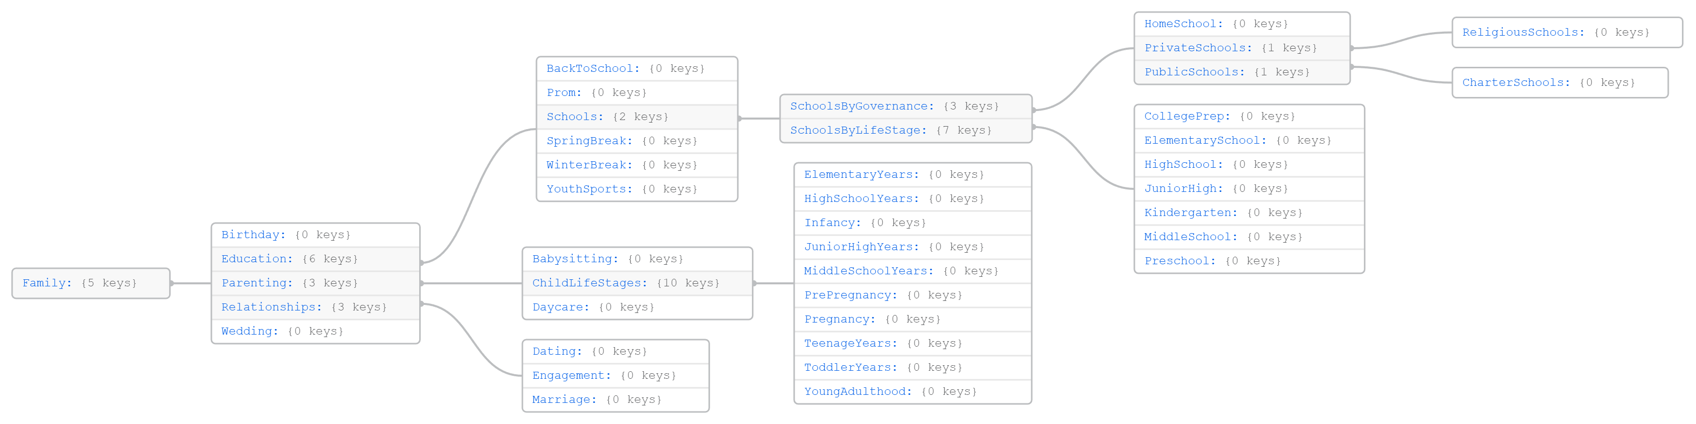
Idea
Ideally, we should have the most general, but useful, collection of categories for Hooray authors to simply re-use, instead of making new terms
Further, we should have these terms organized into a hierarchy, as WordPress allows category hierarchies
This makes using the terms easier, as authors can drill down into more specific sub-terms as needed

Slide 4
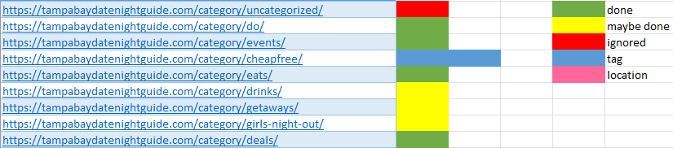
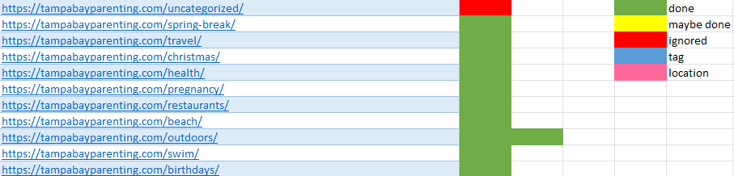
Approach
Took the categories for all four Hooray sites and pulled out common ones to begin the hierarchy
After xxx iterations, we are at version 1.0.0, which consists of xxx category terms
The top-level terms are:
Region: for locations like cities
People: for persons of interest
Family: for family life, education, etc.
Health: for fitness, diet, etc.
News: for general news topics
Animals: for wildlife, pets, etc.
Things To Do: for events, dining, holidays, etc.
Special Content: for reserved content
Home: for beauty, gardening, decoration, etc.
Work: for anything related to jobs
Audience: singles, couples, etc.

Slide 5



Categorization: How To
To keep categorization as controlled as possible, we now have a custom GPT model to recommend categories to authors
https://chat.openai.com/g/g-JAXADHu7r-hooray-post-categorizer
Just paste in the text content of your post when done writing, and it does the work for you
+
=

Slide 6
Categorization Rules
The GPT model is a recommender for authors
They must make the final call
Below are some rules of thumb for final categorization
Ideally, select one (1) region category term, like Orlando
Select no more than five (5) categories in total
Select the most specific terms possible, while considering SEO
Do not hesitate to use terms from more than one top-level term; e.g., a post about Zoos can use the Animals and Things To Do trees
You need to know the category hierarchy to make any final calls
The remaining slides explain the hierarchy

Slide 7
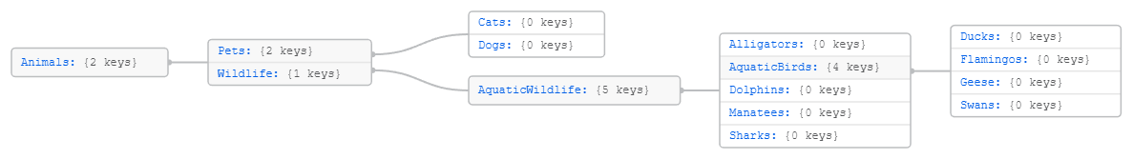
Sub-tree: Animals
For categorizing animals like pets and wild creatures
Specific to Florida currently, but it can be expanded easily

Slide 8
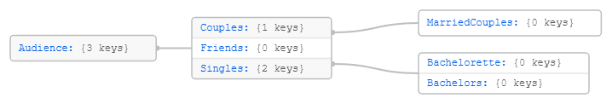
Sub-tree: Audience
For the scenario when an author wants to point at particular people groups, like singles or couples

Slide 9
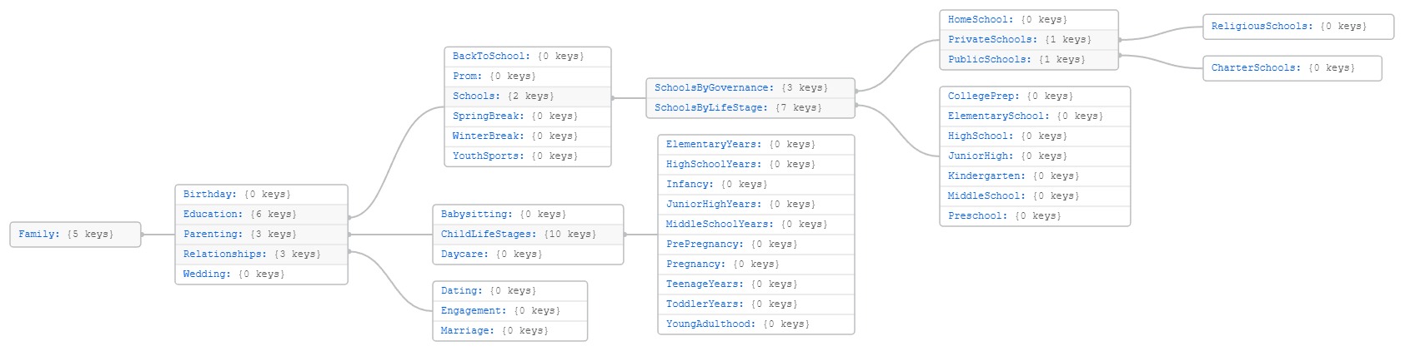
Sub-tree: Family
For family-oriented content
Education is a large sub-term because Hooray focuses mostly on child education
Parenting is the next large sub-term

Slide 10
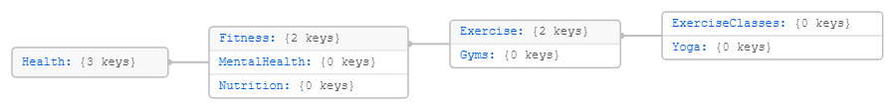
Sub-tree: Health
For content related to health, like exercise and nutrition
See the Dining sub-tree in a later slide

Slide 11
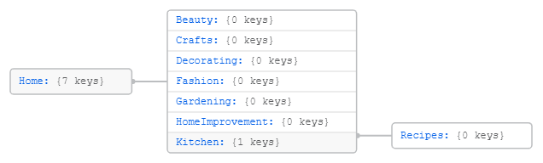
Sub-tree: Home
For the occasional post about content in or around the home

Slide 12
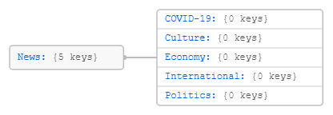
Sub-tree: News
For the occasional post about public events

Slide 13
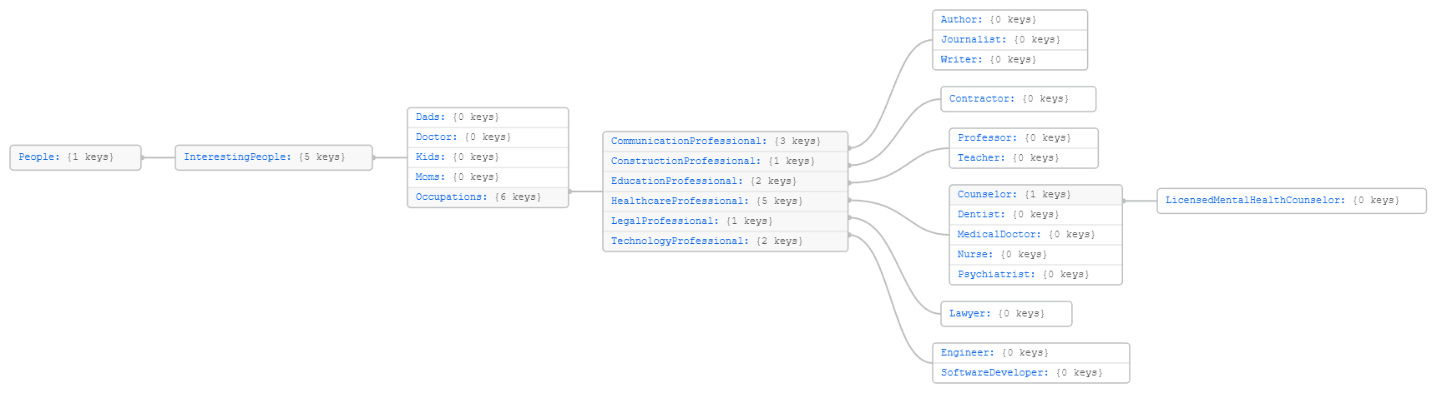
Sub-tree: People
For highlighting interesting people
Occupations has a limited number of terms but can be expanded easily

Slide 14
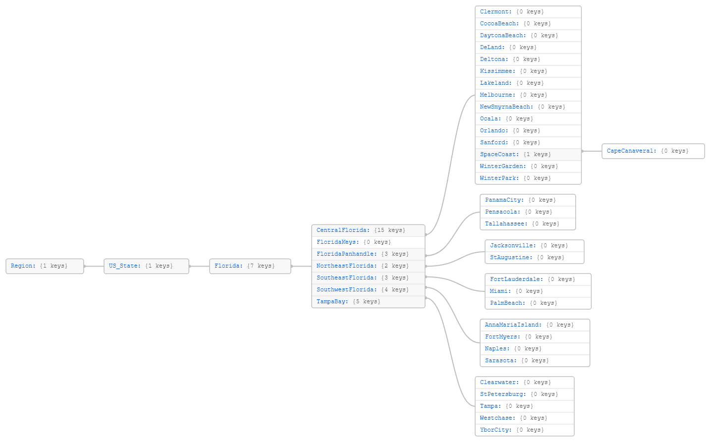
Sub-tree: Region
For noting a particular city

Slide 15
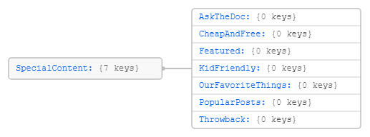
Sub-tree: Special Content
For reserved content and special descriptors used in the past by Hooray authors

Slide 16
“Sub-tree”: Work
A general top-level term to catch anything relating to work, employment, etc.
Work

Slide 17
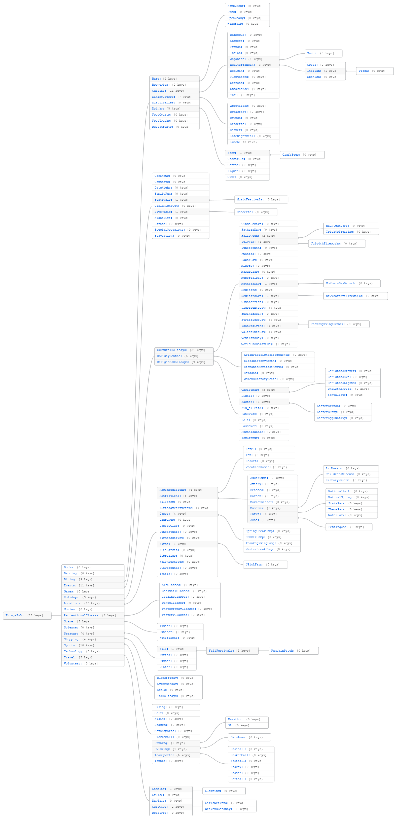
Sub-tree: Things To Do
The largest sub-tree
Too complicated for one slide, so it is broken apart
Books, Dancing, Games, Movies, Science, Technology and Volunteer have no sub-terms
Dining
Events
Holidays
Locations
Recreational Classes
Scene
Seasons
Shopping
Sports
Travel
See next slides for these

Slide 18
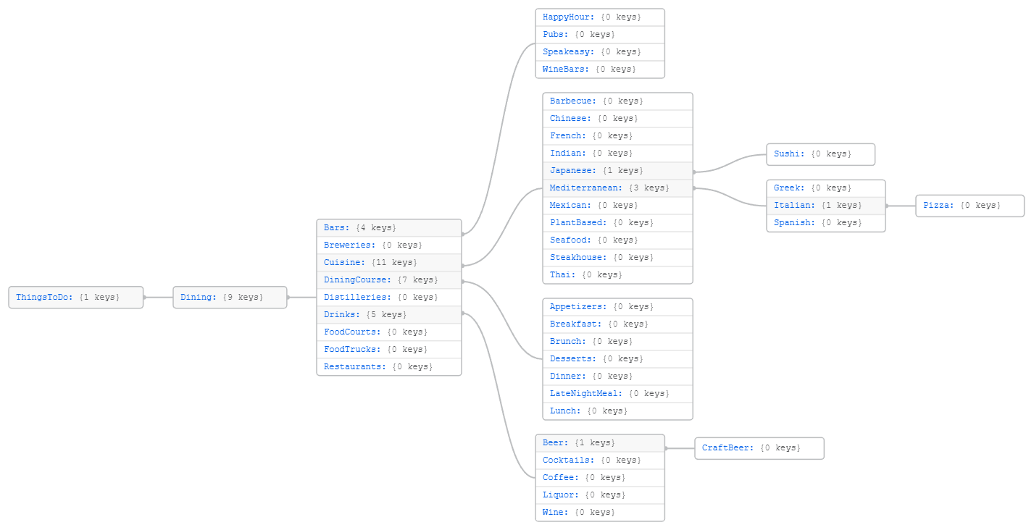
Things To Do Sub-tree: Dining
For anything related to food, drink, places to eat, etc.
Allows for the description of cuisine types

Slide 19
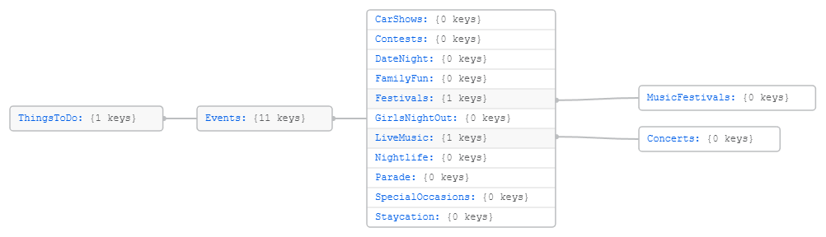
Things To Do Sub-tree : Events
For particular events that are unique from locations

Slide 20
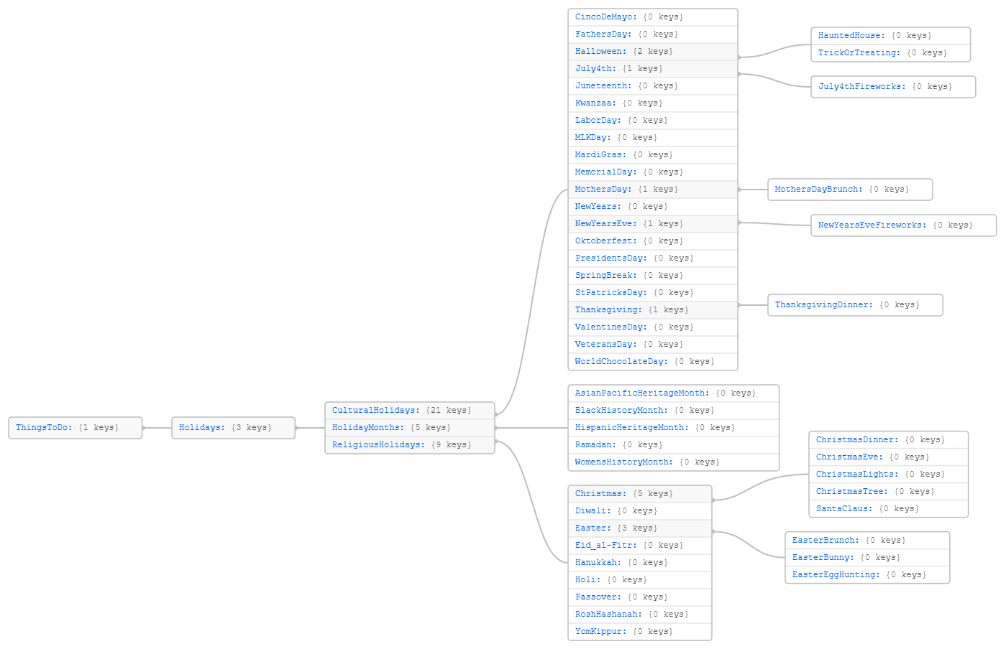
Things To Do Sub-tree: Holidays
For the major holidays
Also includes important holiday aspects, like Christmas Lights

Slide 21
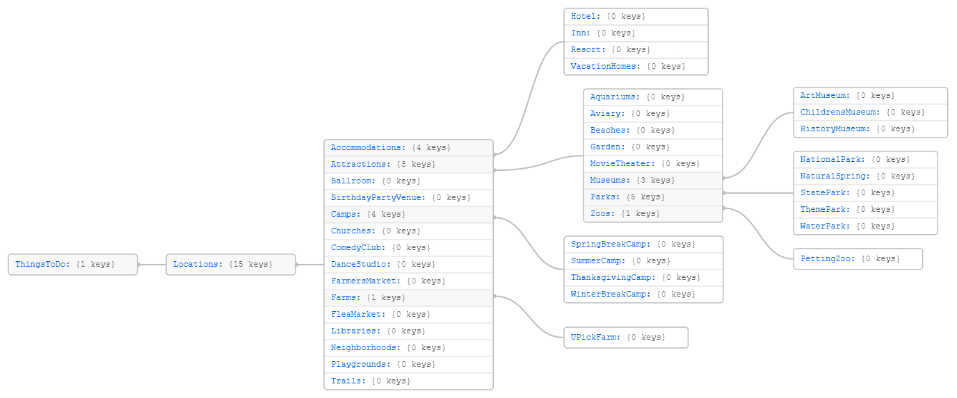
Things To Do Sub-tree: Locations
For locations people go to “to do stuff”, mostly for fun or leisure

Slide 22
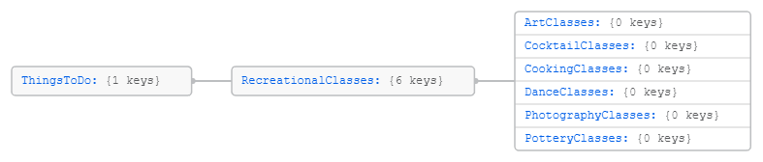
Things To Do Sub-tree: Recreational Classes
For group sessions centering around particular interests

Slide 23
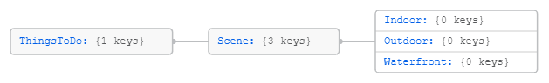
Things To Do Sub-tree: Scene
A useful term if an author wants to categorize something based on the scene
Indoor
Outdoor
Waterfront

Slide 24
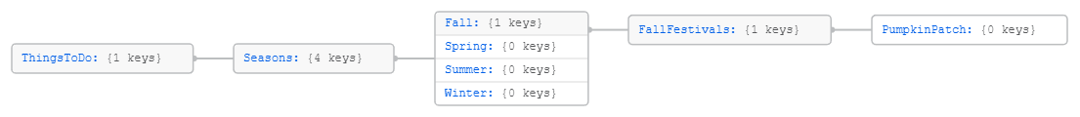
Things To Do Sub-tree: Seasons
Useful for seasonal content

Slide 25
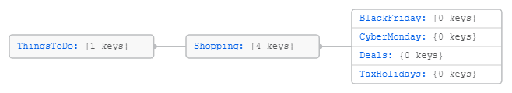
Things To Do Sub-tree: Sports
For anything related to shopping, deals, etc.

Slide 26
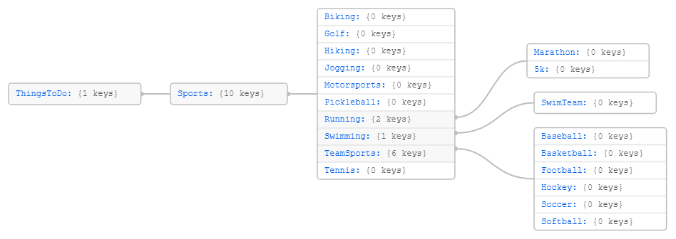
Things To Do Sub-tree : Sports
For athletic and leisurely activities

Slide 27
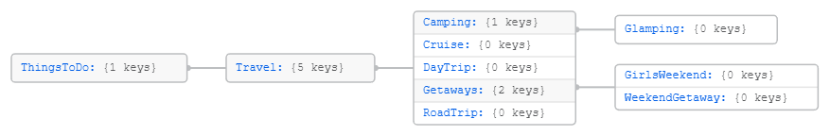
Things To Do Sub-tree: Travel
Distinct from Locations because these terms do not specify any particular location, but the activities surrounding trips to locations

Slide 28
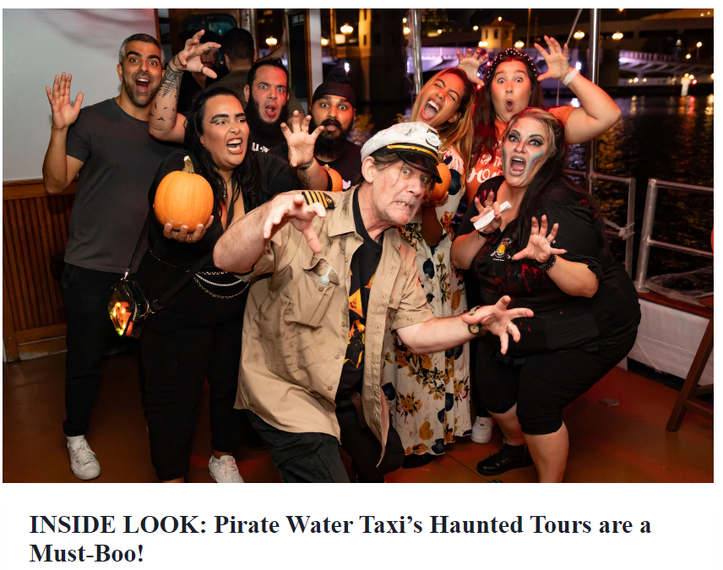
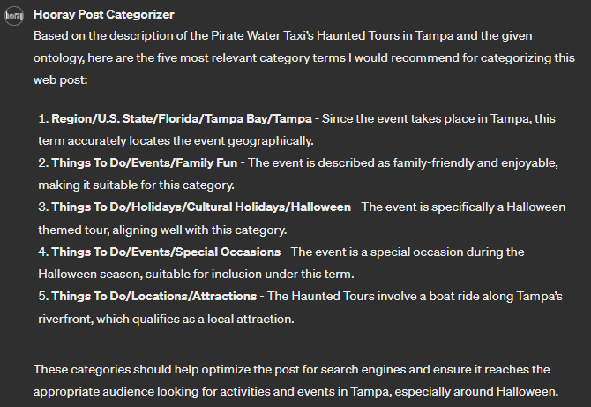
Example Categorization (1)
https://tampabayparenting.com/pirate-water-taxi-haunted-tours/
GPT recommended the following five categories:
Region/U.S. State/Florida/Tampa Bay/Tampa
Things To Do/Events/Family Fun
Things To Do/Holidays/Cultural Holidays/Halloween
Things To Do/Events/Special Occasions
Things To Do/Locations/Attractions
This is good, but it can be customized by the author
Perhaps Special Content/Kid Friendly is a good one to use

Slide 29
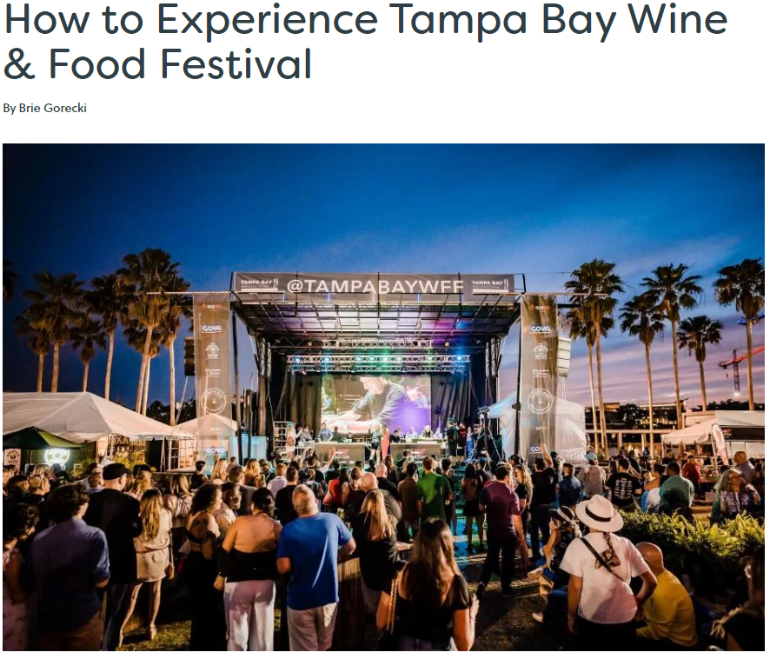
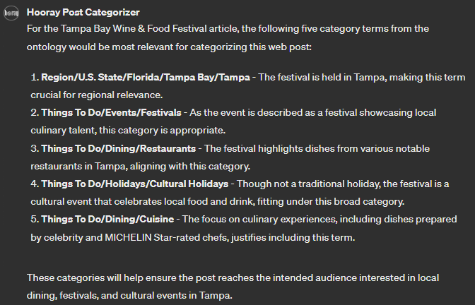
Example Categorization (2)
https://tampabaydatenightguide.com/tampa-bay-wine-food-festival/
GPT recommended the following five categories:
Region/U.S. State/Florida/Tampa Bay/Tampa
Things To Do/Events/Festivals
Things To Do/Dining/Restaurants
Things To Do/Holidays/Cultural Holidays
Things To Do/Dining/Cuisine
Not bad, but it can be added to:
Maybe Special Content/Our Favorite Things is good here
Things To Do/Dining/Drinks/Wine is obviously a good choice

Slide 30
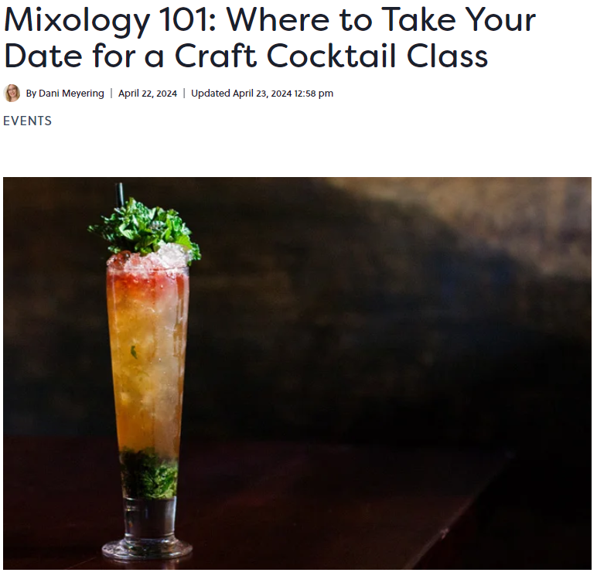
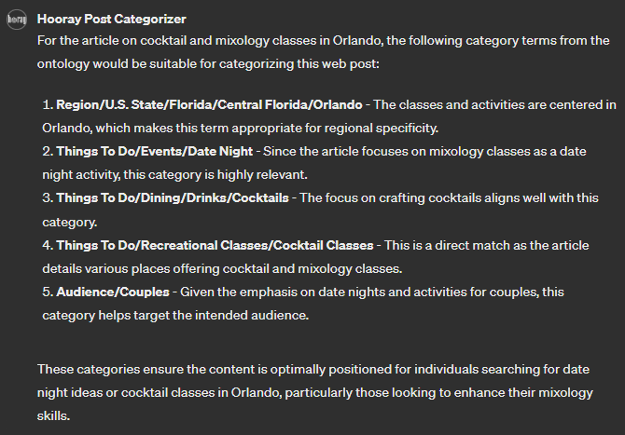
Example Categorization (3)
https://www.orlandodatenightguide.com/mixology-cocktail-class-in-orlando-17223/
GPT recommended the following five categories:
Region/U.S. State/Florida/Central Florida/Orlando
Things To Do/Events/Date Night
Things To Do/Dining/Drinks/Cocktails
Things To Do/Recreational Classes/Cocktail Classes
Audience/Couples
This is actually pretty good
But adjust as needed, with discretion

Slide 31
Reserved Terms
Some terms are in the hierarchy simply for organizational purposes and should not be used by Hooray authors
U.S. State
Use the U.S. state, like Florida, or a city under it
Occupations and the “xyz Professional” terms, like Healthcare Professional
Use a lower term of an actual occupation, like Nurse
Schools by Governance, Schools by Life Stage
Use a lower term, like Home School or Charter School
Child Life Stages
Use a lower term, like Elementary Years
Aquatic Wildlife and Aquatic Birds
Use a lower term for a real animal, like Dolphin or Duck
This is all baked into the GPT model so you do not have to worry about it so much

Slide 32
Instances
You may have noticed: important things like Disney are not in the category hierarchy yet
This is because the category hierarchy is for general types of things, not instances of them
For example, we have Theme Park, but not Disney
We have Restaurant, but not Ninja Ramen at 2452 S Nova Road in Daytona Beach, FL
Etc.
We assume that such instances are tags, not categories
Tag lists are flat (non-hierarchical) and used infrequently
They can be added to a WordPress tag list without much concern
Up to the discretion of Hooray authors

Slide 33
Future
The hierarchy is not done!
We can update it as much as we would like with new terms
With new terms, using the hierarchy is the same
The GPT model is easily updated and the process is the same for all authors

Slide 34
Resources
Email me at prockotyler@gmail.com, or tyler@semanticscience.us
The ontology is hosted publicly at https://github.com/PR0CK0/WebPostOntology/
Training documents (including this PPT) are at https://github.com/PR0CK0/WebPostOntology/tree/main/training
Ontology files (including image and textual renderings) are at https://github.com/PR0CK0/WebPostOntology/tree/main/ontology
The GPT categorizer is at https://chat.openai.com/g/g-JAXADHu7r-hooray-post-categorizer

